Slide 1

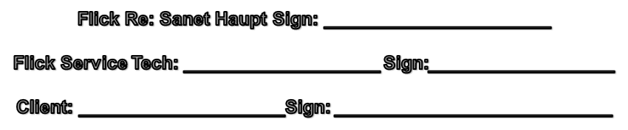
Dinner Mates: 20 Precession Street, Kya Sands
Date: July 2013
Freezer
Chiller
Chiller
10
9
6
7
8
1
2
3
4
5
Legend
Door
1 - 8 Rodent Bait station

Slide 2
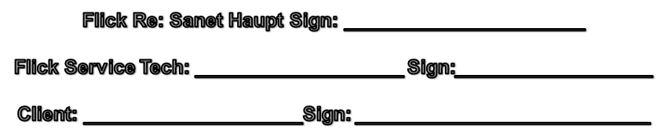
Dinner Mates: 20 Precession Street, Kya Sands
Date: July 2013
Internal boxes
First Floor Plan
1
2
12
7
11
3
8
5
10
9
6
4

Slide 3

Dinner Mates: 20 Precession Street, Kya Sands
Date: July 2013
Internal boxes
Ground Floor Plan
17
16
15
14
13
18
19
20
21
22
23

